Slide 1
RFT Basic and Advanced Training
Srinivas K Kalmady

Slide 2
Contents
DAY1
Automation is…
Different types of automation and tools
Technologies supported by RFT
Tool installation and configuration
Record and Playback
Verification points
Script debugging
Script Assure Technology
Object Maps
Data Driven Testing
Log information to report, capture screenshots
Connecting to external data sources
Hands on exercise

Slide 3
Contents
DAY2
Use of Dynamic objects
Flow control
Pattern based recognition
Manual verification points
Capturing dynamic data from objects
Hands on exercise
Dynamic Find
Handling non-java windows and non-browser windows
Extending scripts with script support features
Developing framework suitable for the project
Running scripts using batch file
Hands on exercise

Slide 4
Automation is….
To save time and resources.
To run script in unattended mode.
To run script in the future.

Slide 5
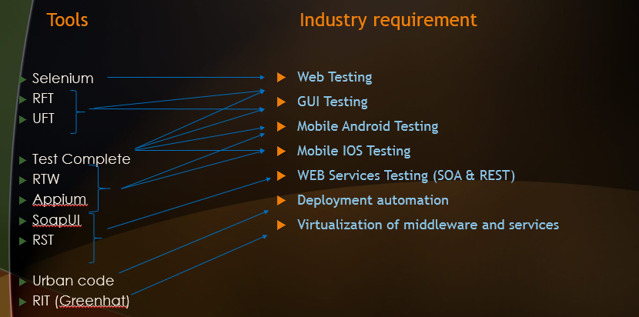
Different types of automation and tools

Slide 6
Technologies supported by RFT
HTML
Java
Windows
.NET
Mainframe
Visual Basic
PDF
Silverlight
Eclipse
SAP
Siebel
Flex
Ajax
Dojo
GEF
PowerBuilder

Slide 7
Tool installation and configuration
Enable Environment for testing:
-- Internet Explorer
-- Java
Configure Applications for testing
-- http://w3.ibm.com

Slide 8
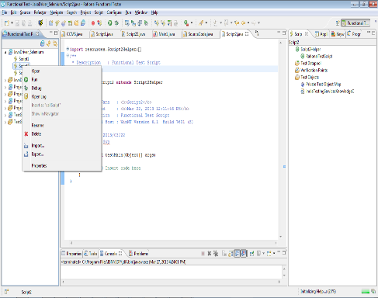
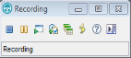
Record and Playback
Click on the Record button to record the new script
Click on the button to record the step in the existing script
Click on Run the button to run the script

Slide 9
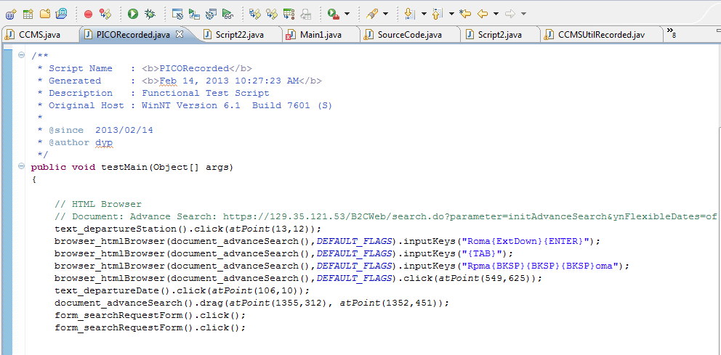
Recorded Script - Sample
The Code View uses Java Script

Slide 10
Verification points in RFT
A Verification Point Verifies data, properties, image and screen of the selected GUI objects in the application under test
Data Verification Point
Verify data for the selected Test Object to see if any changes have occurred, either intentionally or unintentionally.
Properties Verification Point
Verify specific properties for the selected Test Object to see if any changes have occurred, either intentionally or unintentionally.
Image Verification Point
Verify image for the selected Test Object to see if any changes have occurred, either intentionally or unintentionally.
Screen Image Verification Point
Verify full / selected area of screen image to see if any changes have occurred, either intentionally or unintentionally.

Slide 11
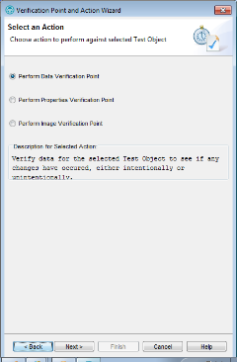
Verification points
From Menu Bar
Select ‘Script → Insert Verification point’ From Test Toolbar

Slide 12
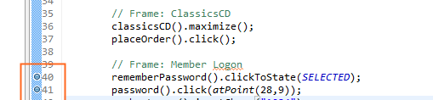
Script Debugging
GUI automation requires so much of maintenance, you will want to learn every time-saving diagnostic technique you can. Stepping through your code with a debugger is just such a technique.
What is Breakpoint and Why Break point ?
A breakpoint is a "stop" marker that you insert next to a line of code. After you add a breakpoint and initiate a debug session, code execution stops at the breakpoint, enabling you to examine data or the state of your application, or step through the code.
To add a breakpoint, simply right-click in the gray left-hand border next to the line of code where you want execution to stop, then pick Toggle Breakpoint from the popup

Slide 13
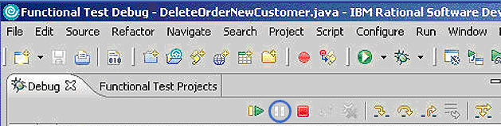
Script Debugging
Variables: This view enables you to examine the values of all the variables currently in scope. You can also change the values of variables in this view. The values are only persistent for the duration of the current debug session.
Breakpoints: This view displays all the breakpoints that you have set, and indicates which ones are enabled or disabled. You can also disable or remove breakpoints in this view, by right-clicking on them.
Suspend: Suspends the running of the debugger until you choose to resume it.
Resume: Execution will continue to the next breakpoint, or to the end of execution if no more breakpoints exist.
Terminate: Terminates the debug session, and returns you to the Functional Test (default) perspective.
Very Important Terms:
1. Step Over: Causes the debugger to proceed to the line of code following the current line. The debugger stays at the same level in the code, rather than moving to a deeper or shallower level.
2. Step Into: Causes the debugger to step deeper into the code, into the method being called by the current line.
3. Step Return: Causes the debugger to step out to a shallower level of the code, to the caller of the current method

Slide 14
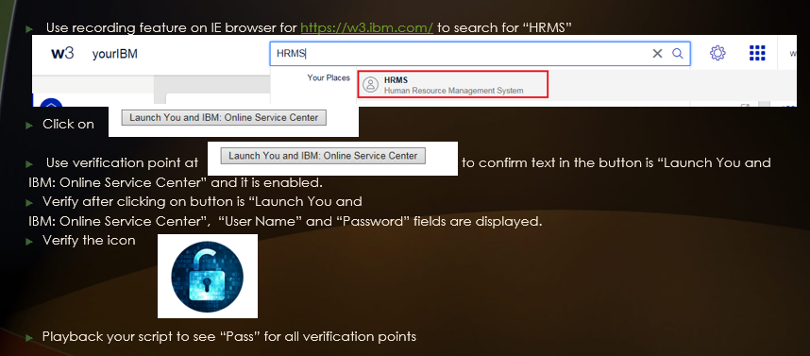
Hands on exercise

Slide 15
CHECK LIST
Automation is…
Different types of automation and tools
Technologies supported by RFT
Record and Playback
Verification points
Script debugging

Slide 16
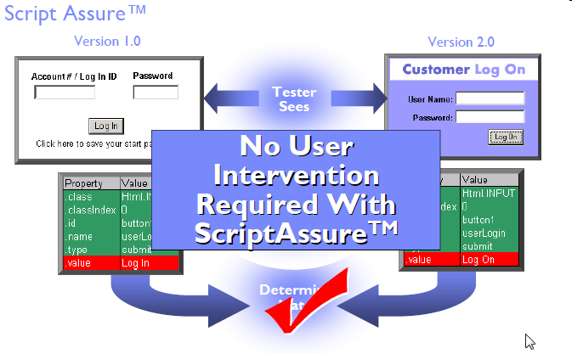
Script Assure Technology

Slide 17
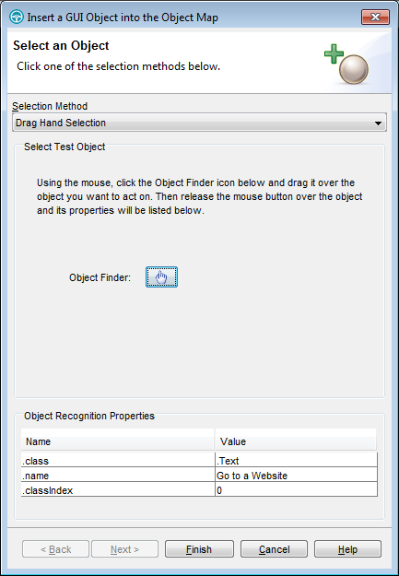
Object Maps
Invoke the ‘Insert a GUI Object into the Object Map’ by click on the above icon in the ‘Test Toolbar’
Highlight the ‘Object Finder’ icon on the required GUI object to add to the object repository

Slide 18
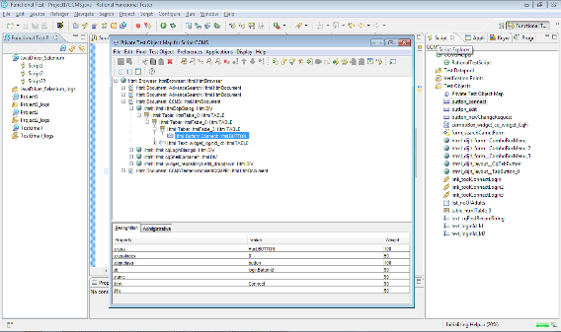
Object Maps
Select any object in Scripts Explorer
Displays the object hierarchy of the object
Displays the object property, its value and Weight-age

Slide 19
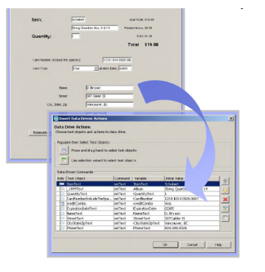
Data Driven script
Reuse the same script to replicate different (realistic) scenarios
Abstracts the test data from the test script
Modify test data without affecting the test script
Add new test cases by modifying the data and
not the test script.
Share the test data with many test scripts.
Wizard driven process
No programming involved
Import data from external sources.

Slide 20
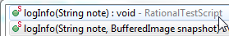
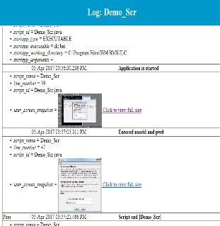
Log information to report, capture screenshots
Examples:
logInfo(" message");
logWarning("message");
logError("message");
------------------------------------
//full screenshot capture
logInfo("message",getRootTestObject().getScreenSnapshot());
//particular object screenshot
logInfo(“message”, MSISDN_button().getScreenSnapshot());

Slide 21
Connecting to external data sources (i) rftdp
Methods
dpString(“column_name”);
dpInt(“column_name”);
//check all iteration completed in datapool or not
dpDone();
// point at the next row
dpNext();

Slide 22
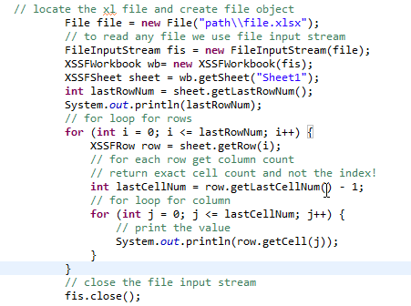
Connecting to external data sources (ii) Excel
Using external libraries it is possible to read / write content from/to excel sheet.
To import libraries, right click on the project → Properties → Java Build Path → Libraries → Add External jars.
Below are some of the Excel libraries
Jxl.jar → http://www.java2s.com/Code/Jar/j/Downloadjxljar.htm
Apache POI → https://poi.apache.org/

Slide 23
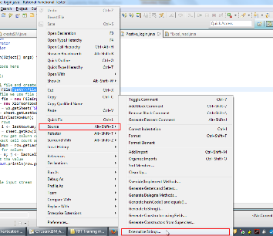
Connecting to external data sources (iii) text file or properties file

Slide 24
Connecting to external data sources (iv) database
-- Import required libraries into your project depending on the database that you are trying to connect.
For eg: For ORACLE db.
ojdbc14_g.jar
ojdbc14.jar

Slide 25
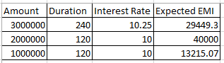
Hands on exercise
Automate testing EMI Calculator from SBI by entering Amount, Duration, Interest rate in web site:
https://www.sbi.co.in/portal/web/home/emi-calculator
Print “EMI Calculated” and “Total Interest” in the console and RFT logs. Capture screenshots for every data tested as given below.
Verify the EMI displayed with “Expected EMI” using verification point.
Note: For the above data use RFT data pool or Excel data pool for data driven testing.

Slide 26
CHECK LIST
Script Assure Technology
Object Maps
Data Driven Testing
Log information to report, capture screenshots
Connecting to external data sources

Slide 27
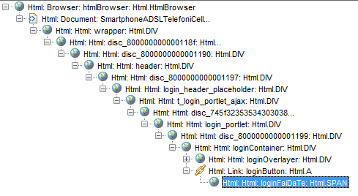
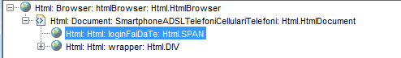
Use of Dynamic objects
Normal Object Dynamic Object
-- works based on the complete hierarchy -- works based on only the parent that is anchored to it
Right click on Object in ObjectMap and select “Convert to Dynamic Test Object”

Slide 28
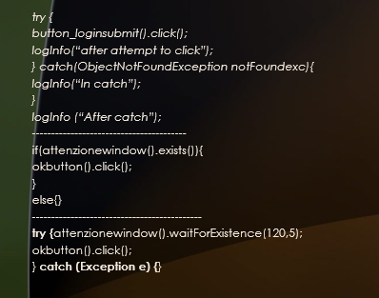
Flow Control
-- Controlling the flow of execution using try catch block.
Examples:

Slide 29
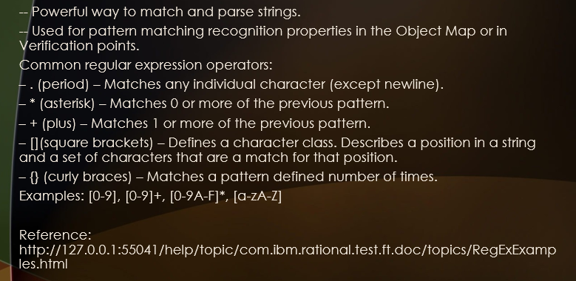
Pattern Based Recognition

Slide 30
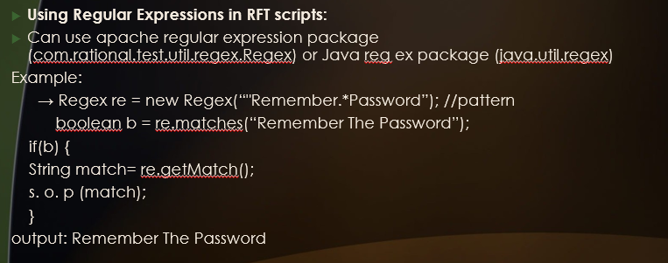
Pattern Based Recognition

Slide 31
Manual Verification points
-- Useful when you create the data for the verification point yourself, and you want to compare the data. For example, the data could be the result of a calculation or could come from an external source, such as a database.
→ IFtVerificationPoint vpManual (java.lang.String vpName, java.lang.Object actual)
→ IFtVerificationPoint vpManual (java.lang.String vpName, java.lang.Object expected, java.lang.Object actual)
Examples:
vpManual ("manual1", "The rain in Spain").performTest();
vpManual ("manual2", "The rain in Spain", "The Rain in Spain").performTest();

Slide 32
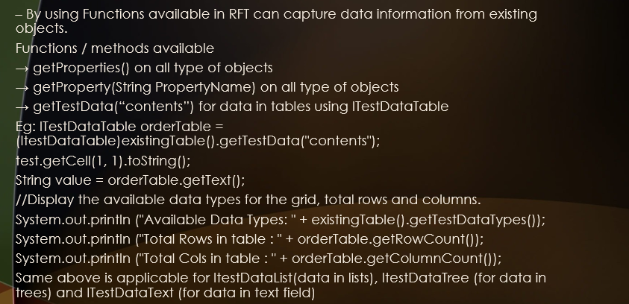
Capturing dynamic data from objects

Slide 33
Hands on exercise
In automation script, Use http://www.google.com to search for following texts “IBM India”, “IBM Singapore”, “IBM Australia” where these data’s are stored in any data pool.
After searching text data, click on respective links after verifying using manual verification point that they are present. Wait for the page to open and then close it.
Note:
1. Convert link objects to “Dynamic object”
2. Attach every new page in RFT automation report.

Slide 34
CHECK LIST
Use of Dynamic objects
Flow control
Pattern based recognition
Manual verification points
Capturing dynamic data from objects

Slide 35
Dynamic Find
RootTestObject to = RootTestObject.getRootTestObject();
TestObject [] array = to.find(atDescendant(".class", "Html.TABLE"));
GuiTestObject gui= (GuiTestObject)array[0];
gui.click();
Finding links in a table
TestObject [] array = htmlTable.find(atDescendant(".class", "Html.A"));

Slide 36
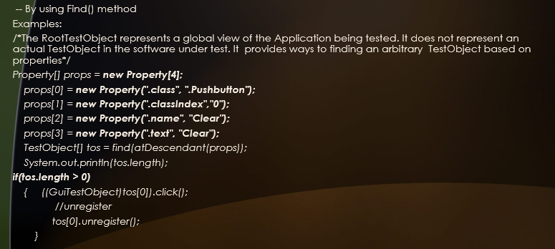
Dynamic Find

Slide 37
Handling non-java windows and non-browser windows
– Interface classes
IWindow : Used to access the operating system's windows and objects. This can be used on either Microsoft Windows or Linux.
IScreen: Used to access and interact with windows and other objects from the operating systems.
– Key Methods
getScreen() method can be used to get a screen object.
getTopWindows() can be used to get the top level windows available during run time.
getActiveWindow() can be used to get the current active window.
getText() used to get values from a particular window.
inputKeys() used to send a string or keystroke (such as Ctrl, Alt, Shift and so forth) to the current active window.
inputChars() used to send a string value to the current active window.

Slide 38
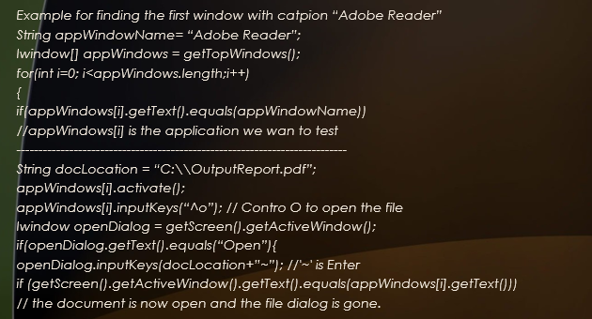
Handling non-java windows and non-browser windows

Slide 39
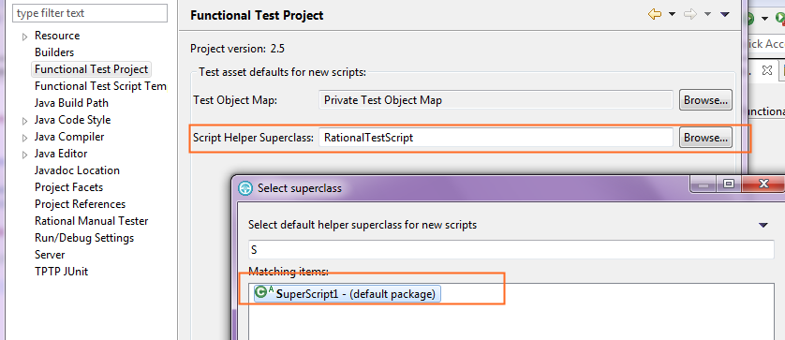
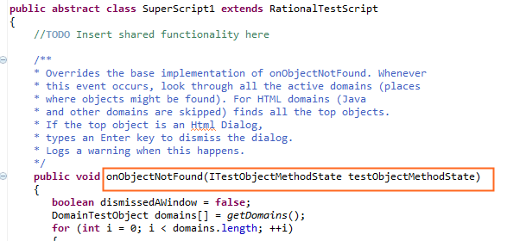
Extending scripts with script support features
Including external jar files
Extending a script with Helper super class for overriding /defining new functions to be available in RFT.

Slide 40
Developing framework suitable for the project
-- Set of assumptions, concepts, and practices that constitute a work platform or support for automated testing
-- For low cost maintenance.
Types of Frameworks:
Functional Decomposition (Or Modular)
Data driven
Keyword or table driven
Hybrid
Example framework: ITCL / IBM framework. https://www.ibm.com/developerworks/rational/library/06/0822_goel/

Slide 41
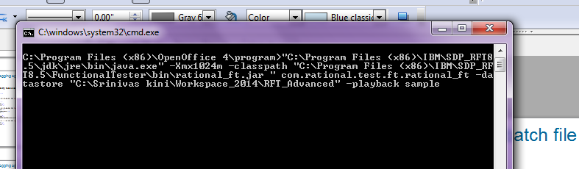
Running scripts using batch file
Do not require RFT to be opened.
Useful in scheduling batch runs using windows schedule features.
Following parameters are passed in the batch file:
– Where the project is
– That you want to execute a script
– Which script to execute
BATCH file content: "C:\Program Files (x86)\IBM\SDP_RFT8.5\jdk\jre\bin\java.exe" -Xmx1024m -classpath "C:\Program Files (x86)\IBM\SDP_RFT8.5\FunctionalTester\bin\rational_ft.jar " com.rational.test.ft.rational_ft -datastore "C:\Srinivas kini\Workspace_2014\Mentor_Project" -playback common_functions

Slide 42
Hands on exercise
Automate website http://www.vodafone.it to hover on “Fai da Te” and click on “Accedi” button.
Enter user “tester” and password “1234” and click on “Submit”, verify the message displayed.
Note:
1. Use dynamic find to find “Fai da Te” object.
2. Attach every new page in RFT automation report.
3. Use excel data driven technique to pass username and password.

Slide 43
CHECK LIST
Dynamic Find
Handling non-java windows and non-browser windows
Extending scripts with script support features
Developing framework suitable for the project
Running scripts using batch file

Slide 44
Q & A

Slide 45
Thank you

